Slide 1



YANA ILCHEVA
Job Application
Tracking System
Vibe Jobs

Slide 2


TABLE OF
Contents
01
Creator
02
Project Overview
03
Used Technologies
04
Future Improvements
07

Slide 3
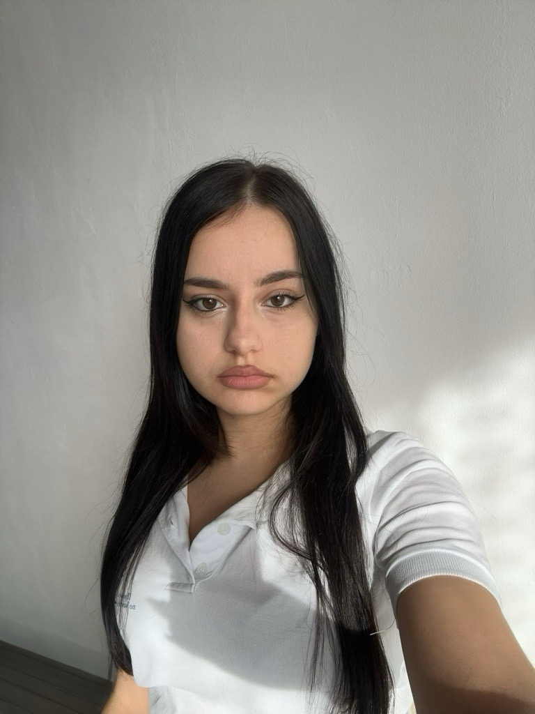
Creator
Yana Zhivkova Ilcheva
YZIlcheva21@codingburgas.bg
Vibe Jobs
Page 01 of 07

Slide 4

Project
Overview
Web-based system to simplify job searching and application.
Users:
- Applicants: Browse jobs, apply, and track status.
- Admins: Create and manage job ads, process applications.
Vibe Jobs
Page 0 of 07

Slide 5

USED TECHNOLOGIES
- JetBrains Rider
- Visual Studio Code
- Figma
- SSMS
Vibe Jobs
Page 03 of 07

Slide 6


Future Improvements
Implement better form validation
Improve the front-end interface
Enhance admin dashboard and filtering options
Vibe Jobs
Page 04 of 07

Slide 7

LET’S MOVE TO
THE PROJECT

